Slide 1
Collaboration with the Oresund and Fehmarnbelttunnel

Slide 2
Who is who from the Netherlands
Brenda Berkhout (chair committee Joints)
Ellen van Eijk (project-assistant international COB)
Karin de Haas (director COB)
Hans Mortier (chair committie Deformations)
Johan Naber (senior advisor Rijkswaterstaat, liaison COB)
Willy Peelen (projectleader workpackage C (instruments))
Erik Schlangen (chair committee Degradations)
Hans de Wit (projectleader SHA)
Monday, 08 February 2021

Slide 3
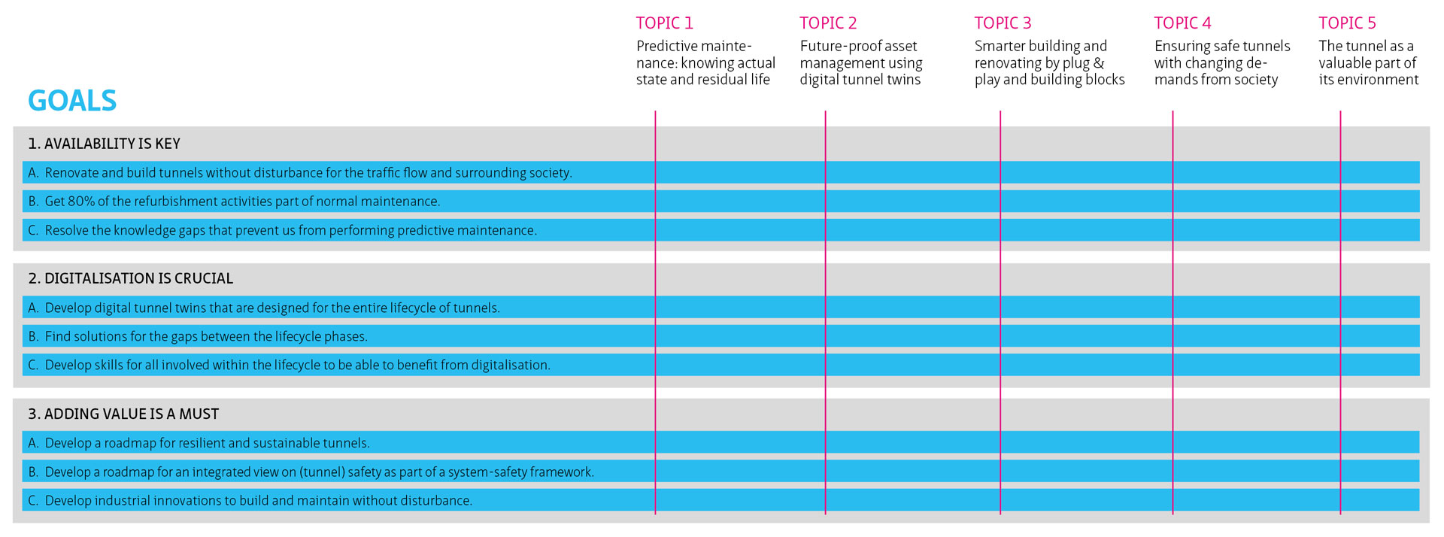
European position paper on tunnels
Monday, 08 February 2021

Slide 4
3 topics most evolved:Building an European network on basis of the ‘Bring your own tunnel’-concept
CIVIL
SAFETY
VALUE
Monday, 08 February 2021

Slide 5
Deliverables up till now
Know your tunnel (guideline for crucial information for the assetowner) (NL)
Checklist for risks (civil and interfaces civil/installations (NL)
Checklist for sustainability (NL)
SHA- approach (ENG)
Working program civil 2030 (ENG)
Monday, 08 February 2021

Slide 6
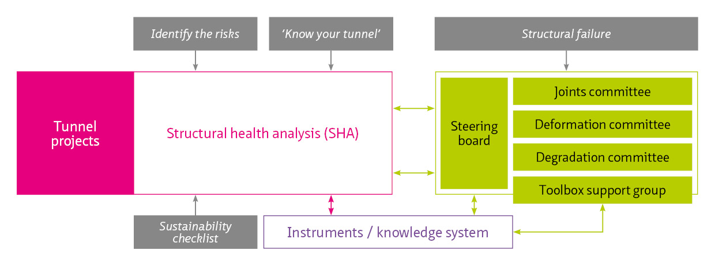
Predictive maintenance and knowing the actual residual life of tunnels
Monday, 08 February 2021

Slide 7
Work package B SHA (22 tunnels)
Work packages
Work package C
Instrumentation
Work package D
Study + PhDs
Work package A
Steering Committee
Supervisory Committee instrumentation
Joints Committee
Deformations Committee
Degradation Committee
Monday, 08 February 2021

Slide 8
Work package B Structural Health Analysis

Slide 9
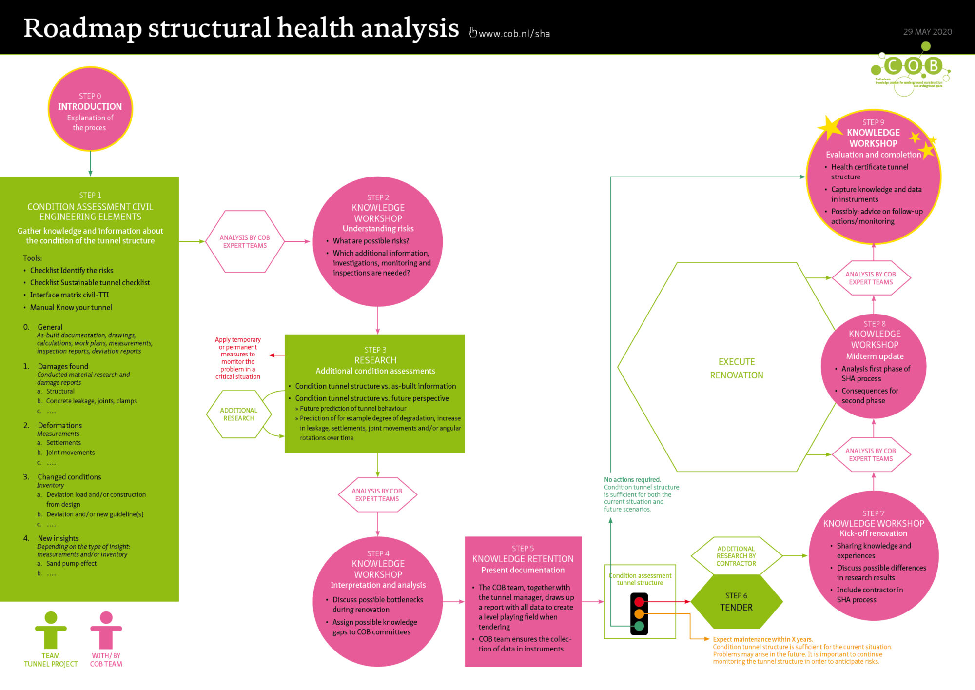

Slide 10
Role of COB Committees
Deliver experts for SHA-teams
Assist tunnel managers and SHA-teams in interpreting the results of SHA
Reducing knowledge shortfalls
Generalisation of knowledge
Reporting and contribution to instruments (WP C)
Initiating studies outside SHA
Brenda Berkhout: Coordinator…coordinates everything together with COB-director
Notes:
Studies outside investigations for implementation within SHA.

Slide 11
Committee Joints
Brenda Berkhout

Slide 12
Deliverables and plans for the upcoming period
Completed draft report of immersed joints inspection
Expansion to railway tunnels and non-national government tunnels and Flanders
Launch investigations into:
- Deformations of omega profiles
- GINA profiles being forced inwards by sand pump
Application of cathodic protection
Performance of transverse connections

Slide 13
Committee deformation
Hans Mortier

Slide 14
Deliverables and plans for the upcoming period
Post-diction of 5 to 6 immersed tunnels in the Netherlands showing ‘problematic’ behaviour
Prediction of deformations in remaining lifetime, defining most appropriate mitigating measures and moment when they should be installed
Define most appropriate monitoring programme including threshold values (signalisation, intervention, limit)
Expansion to railway tunnels and non-national government tunnels, other countries and other tunnel types (bored tunnels)
Include existing case histories showing similar symptoms

Slide 15
Committee degradation
Erik Schlangen

Slide 16
B : Early-Age-Thermal cracks
Major Cause:
The major cause of the cracks is restrained shrinkage. Shrinkage happens upon cooling down of the walls that have heated up due to heat of hydration. Shrinkage is further increased by autogenous shrinkage. The shrinkage leads to tensile stresses and possible cracks if the deformation s restrained. Restraining is due to internal gradients in the elements and connection to other elements in the structure.
Prevent:
To prevent ‘leaking’ early age cracks the following measures can be used:
Optimize concrete mix (low heat, less shrinkage)
Decrease mix temperature
Internal cooling during and after casting
Optimize casting sequence
Extra reinforcement to limit crack width
And some more….
Repair:
Crack injection.
Self-healing concrete.
Description:
Early Age Thermal cracks are typically found in massive concrete structures with a thickness larger than 0.5 m, but sometimes also in thinner structures.
In Tunnels they are often found in outer walls. The cracks are completely through the cross section of the wall and if it is a water-retaining structure cracks are visible because they are leaking.
When and Where:
Early-age-thermal cracks typically occur 2 to 4 weeks after casting the outer walls when they are cooling down.
They can also form later, because the autogenous shrinkage increases internal stresses at a later stage, or water level or pressure is applied later. Furthermore after a cold period (winter) new cracks can form.
Cracks are typically found in walls on slab, but can also be found in the deck or bottom slab, especially when cast on top of under-water-concrete.
NDT:
Visual inspection ……
-….
Sensing and Monitor:
To detect early-age cracking (especially in structures that are difficult to inspect) internal ‘crack’-sensors or ‘water’-sensors should be developed and installed.
(note that strain sensors do not work. The strain is zero, until it localizes in a crack).

Slide 17
Work package C Instruments
Willy Peelen
Monday, 08 February 2021

Slide 18


Context Instruments in COB Tunnel Proposition
T
Information
to be retained
Fundamental research
Degradation, Joints, deformations
Knowledge Retainment
System
Structural Health Analyses
Sustainability, RiK, Ken je tunnel
Knowledge Enrichment
Deformation
Structural Health Analysis
Tunnel interviews
Measurements and data
(e.g. Deformation)

Slide 19

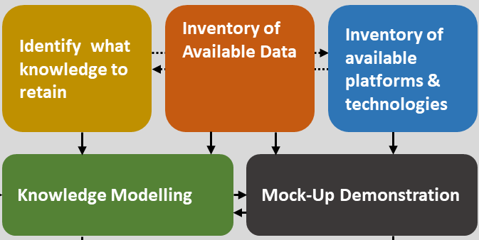
Knowledge Retainment System
Development PLAN 2020
Mock-up
Demonstrate the capture, acquisition and re-use of the knowledge and expertise of tunnel experts
Activity | Method
Identifying tunnel knowledge properties | Interwiews with the tunnel experts Desk research
Inventory of available data and information | Input SHA & experts teams
Modelling knowledge | Desk research
Demonstration (Mock-Up) | Desk research & Stakeholders Workshop

Slide 20
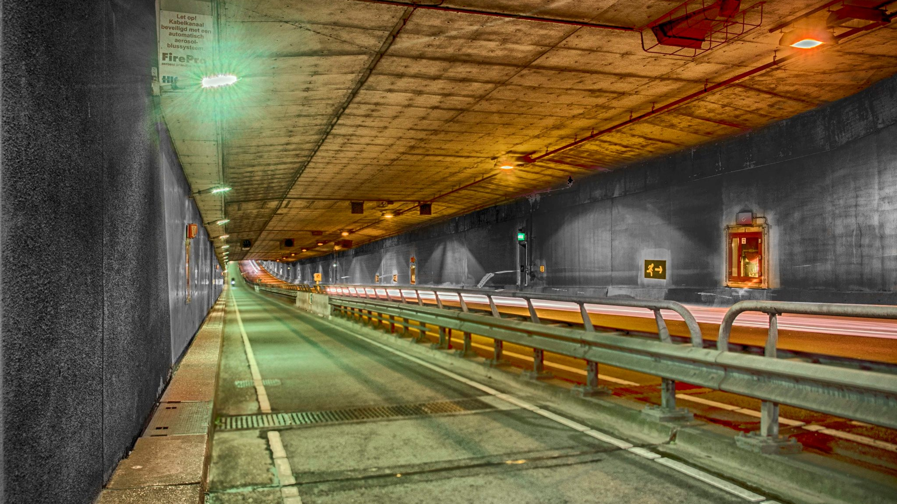
Thank you

Slide 21
Work package D Research, PhD’s etc
Brenda Berkhout
Monday, 08 February 2021

Slide 22

Monitoring Development of Lifecycle models
Fibre Optic BOTDA
Data
Site Investigation
Temperature
Operational State
Traffic Control
GSM
Acoustic Shear Wave
Soil
&
Water
Settlements
Tunnel Construction
Distributed Mesh
Installation & Operation
Energy Use
Extern
In-Car
LVDT
FBG
Waterway
Weather
Methods
Soil-Structure Interaction
Sensor Fusion
Deep Learning
Structural Health
Materials
Tunnel Construction
Installations
Tunnel System

Slide 23

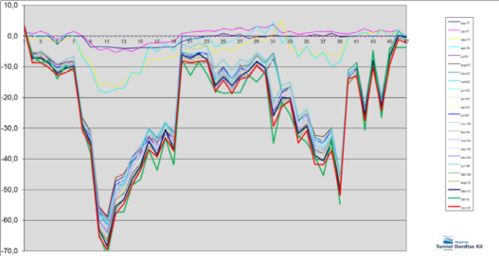
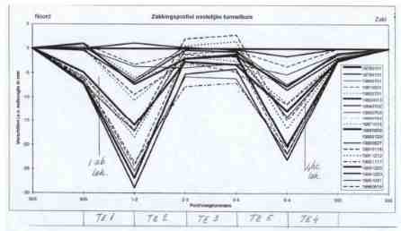
Renovation Solving knowledge shortfalls in civil structures
Deformation
Degradation
Joints
Modular renovation
Settlement measurements on the Kiltunnel (above) and the Heinenoordtunnel (to the right). Both examples show that settlement is greater than the initially estimated 0-2 mm.

